Slide 1

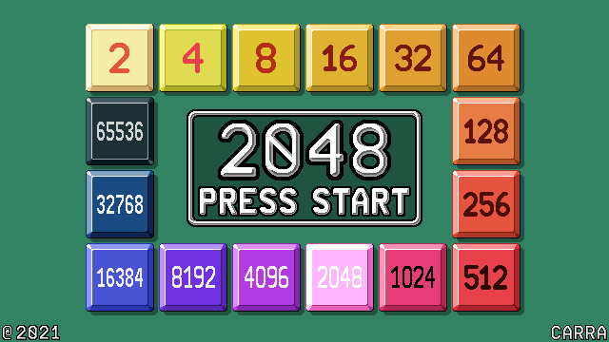
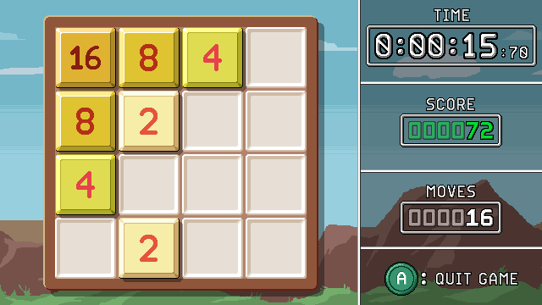
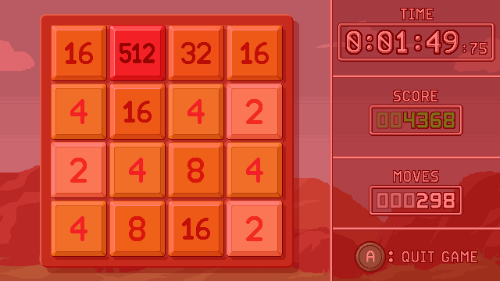
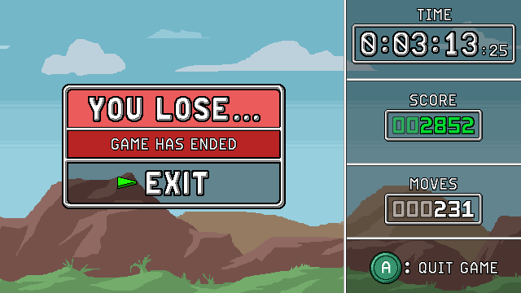

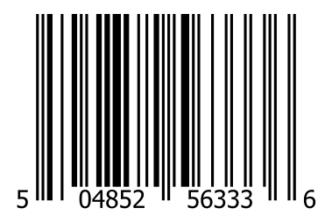

The classic is back, in a remastered version.
2048 is an accessible puzzle game: move the board to make matching tiles merge into greater numbers. Try to keep it up and reach 2048 while new tiles keep being added!
This new version features improved graphics and music. Compared to the original, it feels like an arcade version of 2048! You can also know your times if you are into speedrunning.
If you get good enough you may even go further beyond 2048 and try to reach greater numbers. Let’s see what you can do...
This game is free and open source!
Get the game binaries and source code online.
CONTAINS ONLY INSTRUCTIONS
IN ENGLISH
Only for use with Vircon32 consoles.
Not compatible with other systems.
This seal is your guarantee that this product’s quality has been ensured by the Vircon32 community.
GAME SUITABLE FOR ALL AGES

